Slide 1
Kubeflow
End-to-End Machine Learning Made Scalable and Portable

Slide 2
Agenda
What is Kubeflow ?
6WH Model
Live Demo
Q&A

Slide 3

What is Kubeflow?
An open-source machine learning platform on Kubernetes.
Provides tools to build, train, deploy, and manage ML models at scale.
Designed to simplify ML workflows on cloud & on-prem.

Slide 4
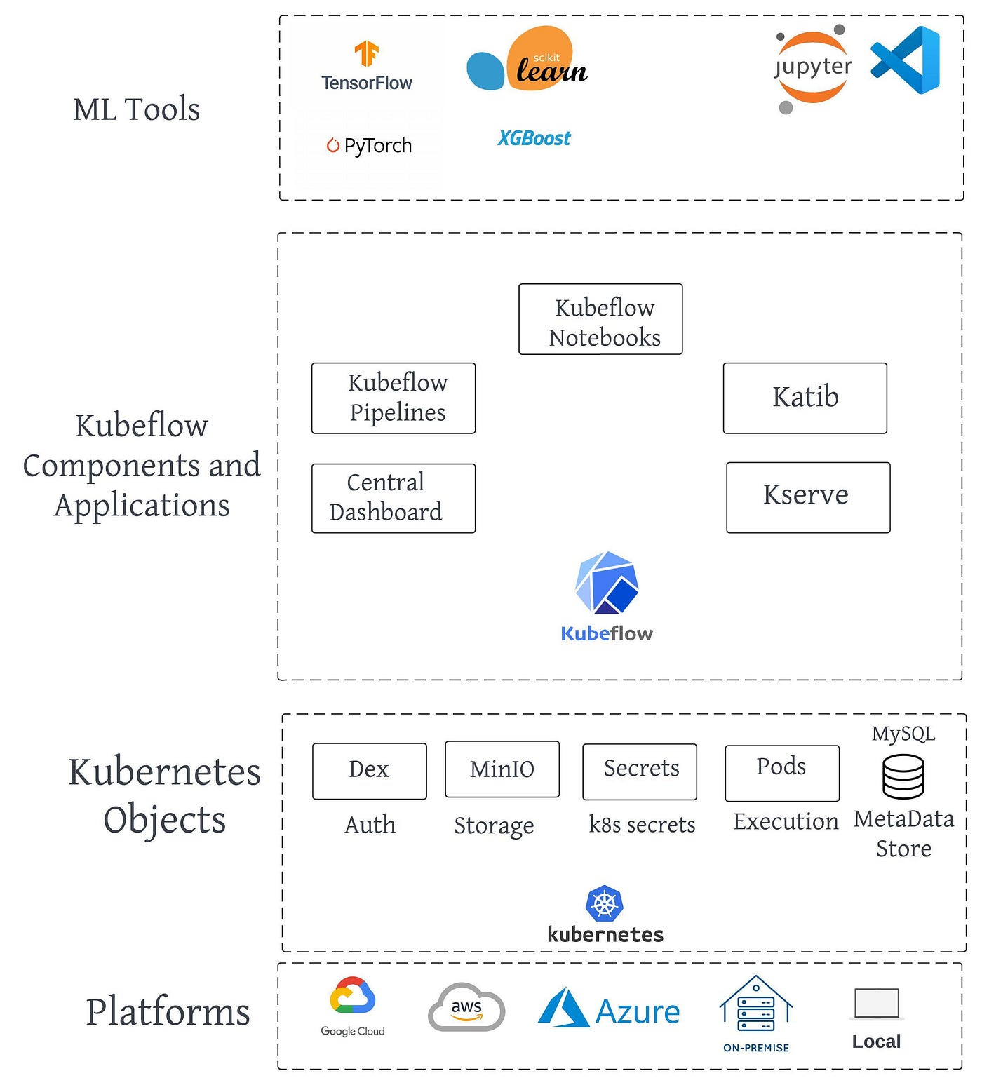
Components of Kubeflow

Slide 5
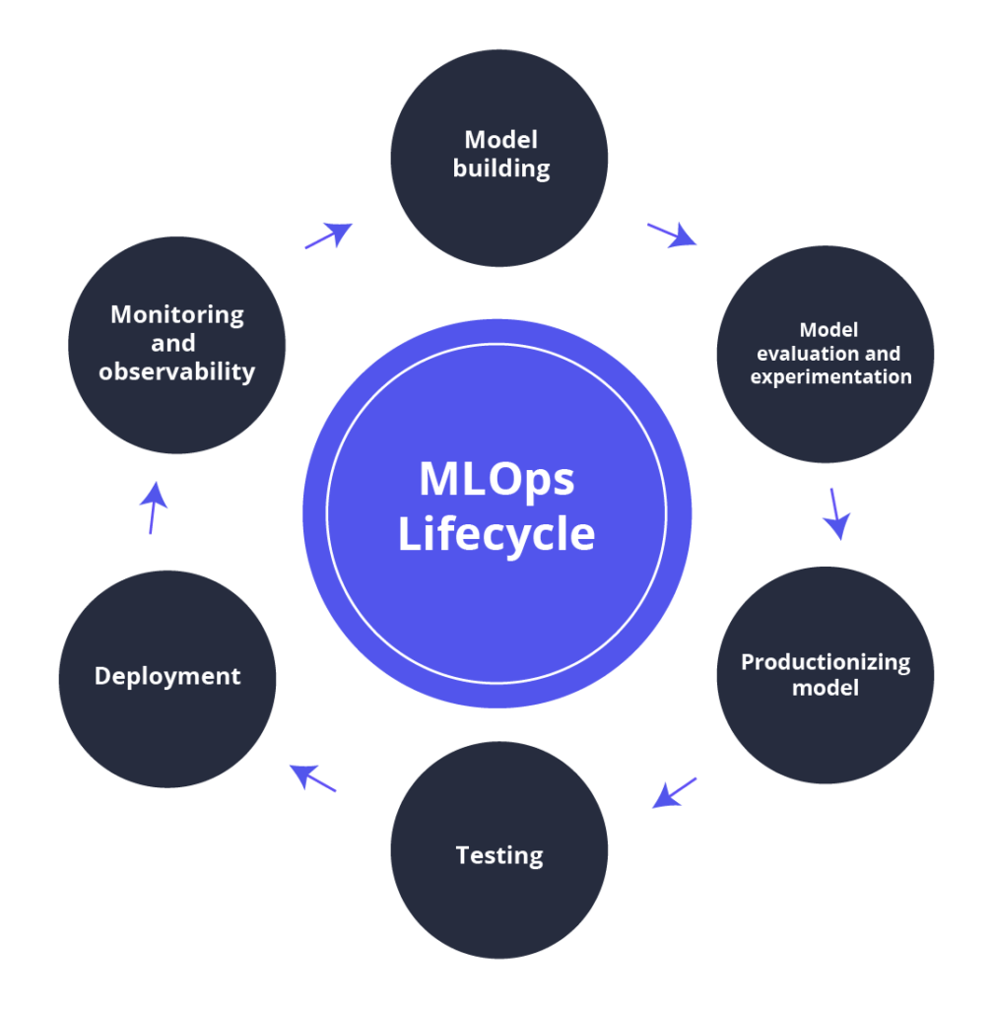
ML-Ops Lifecycle

Slide 6

Why Kubeflow?
Need for reproducibility and scalability.
ML lifecycle (data prep → training → serving) is complex.
Integrates seamlessly with Kubernetes (containers, scaling, portability).
Supports multiple ML frameworks (TensorFlow, PyTorch, Scikit-learn, XGBoost, etc.).

Slide 7


What If Kubeflow is Not Available?
Teams manually manage training pipelines.
Scaling models across environments becomes hard.
No unified interface for ML pipelines.
Increased DevOps overhead for ML teams.

Slide 8
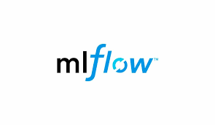


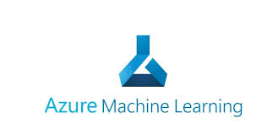
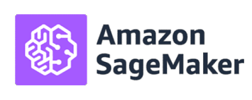
What are the Alternatives?
MLflow – great for experiment tracking & deployment.
Airflow – for pipeline orchestration, not ML-native.
SageMaker (AWS), Vertex AI (GCP), Azure ML – managed services.

Slide 9
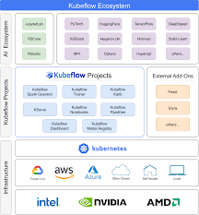
When to Use Kubeflow?
When running ML workloads on Kubernetes clusters.
Need end-to-end workflow orchestration.
Multi-cloud or hybrid ML setup.
Use cases: Recommendation systems, fraud detection, NLP, computer vision.

Slide 10
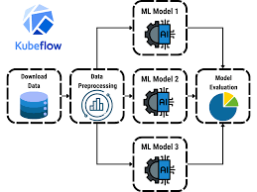
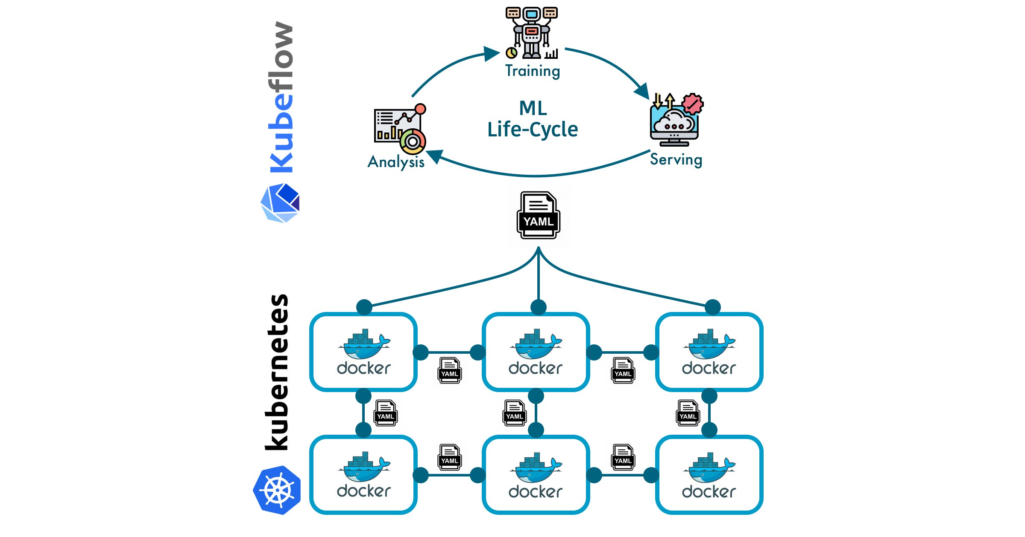
Best Scenarios for Kubeflow
Enterprises with existing Kubernetes infra.
Teams needing scalable model training with GPUs/TPUs.
ML teams collaborating with DevOps.
Multi-tenant ML environments.

Slide 11

How to implement Kubeflow?
Install Kubeflow on Kubernetes (e.g., via kfctl or kubeflow-manifests).
Use Kubeflow Pipelines to design workflows.
Train models with distributed frameworks (TFJob, PyTorchJob).
Deploy trained models using KFServing or KServe.
Monitor performance with Kubeflow Central Dashboard.

Slide 12

Live POC Demo Example
Deploy Kubeflow on Minikube.
Create a pipeline with data preprocessing → training → evaluation.
Deploy model via KFServing.
Access through Kubeflow dashboard.

Slide 13

Summary
Kubeflow = ML + Kubernetes synergy.
Simplifies ML lifecycle management.
Portable, scalable, cloud-agnostic.
Helps bridge Data Science ↔ DevOps gap.

Slide 14

Q & A

Slide 15
Abishek K
Junior - Software Engineer

